Slide 1
Clustering
Clustering is the task of identifying similar instances and assigning them to clusters, or groups of similar instances.
Two different kinds of clusters
Some algorithms look for instances centered around a particular point, called a centroid.
Others look for continuous regions of densely packed instances: these clusters can take on any shape.
Some algorithms are hierarchical, looking for clusters of clusters.

Slide 2
Application of Clustering
Clustering is used in a wide variety of applications, including these:
For customer segmentation
You can cluster your customers based on their purchases and their activity on your website.
This is useful to understand who your customers are and what they need, so you can adapt your products and marketing campaigns to each segment.
For example, customer segmentation can be useful in recommender systems to suggest content that other users in the same cluster enjoyed.
For data analysis
When you analyze a new dataset, it can be helpful to run a clustering algorithm, and then analyze each cluster separately.

Slide 3
Clustering
As a dimensionality reduction technique
Once a dataset has been clustered, it is usually possible to measure each instance’s affinity with each cluster (affinity is any measure of how well an instance fits into a cluster).
Each instance’s feature vector x can then be replaced with the vector of its cluster affinities.
If there are k clusters, then this vector is k-dimensional. This vector is typically much lower-dimensional than the original feature vector, but it can preserve enough information for further processing.
For anomaly detection (also called outlier detection)
Any instance that has a low affinity to all the clusters is likely to be an anomaly.
For example, if you have clustered the users of your website based on their behavior, you can detect users with unusual behavior, such as an unusual number of requests per second. Anomaly detection is particularly useful in detecting defects in manufacturing, or for fraud detection.

Slide 4
Clustering
For semi-supervised learning
If you only have a few labels, you could perform clustering and propagate the labels to all the instances in the same cluster. This technique can greatly increase the number of labels available for a subsequent supervised learning algorithm, and thus improve its performance.
For search engines
Some search engines let you search for images that are similar to a reference image. To build such a system, you would first apply a clustering algorithm to all the images in your database; similar images would end up in the same cluster.
Then when a user provides a reference image, all you need to do is use the trained clustering model to find this image’s cluster, and you can then simply return all the images from this cluster.
To segment an image
By clustering pixels according to their color, then replacing each pixel’s color with the mean color of its cluster, it is possible to considerably reduce the number of different colors in the image. Image segmentation is used in many object detection and tracking systems, as it makes it easier to detect the contour of each object.

Slide 5
K-Means Clustering
K-Means Clustering groups similar data points into clusters without needing labeled data. It is used to uncover hidden patterns when the goal is to organize data based on similarity.
Helps identify natural groupings in unlabeled datasets
Works by grouping points based on distance to cluster centers
Commonly used in customer segmentation, image compression, and pattern discovery
Useful when you need structure from raw, unorganized data
The vast majority of the instances were clearly assigned to the appropriate cluster, but a few instances were probably mislabeled (especially near the boundary between the top-left cluster and the central cluster).
Indeed, the K-Means algorithm does not behave very well when the blobs have very different diameters because all it cares about when assigning an instance to a cluster is the distance to the centroid.

Slide 6
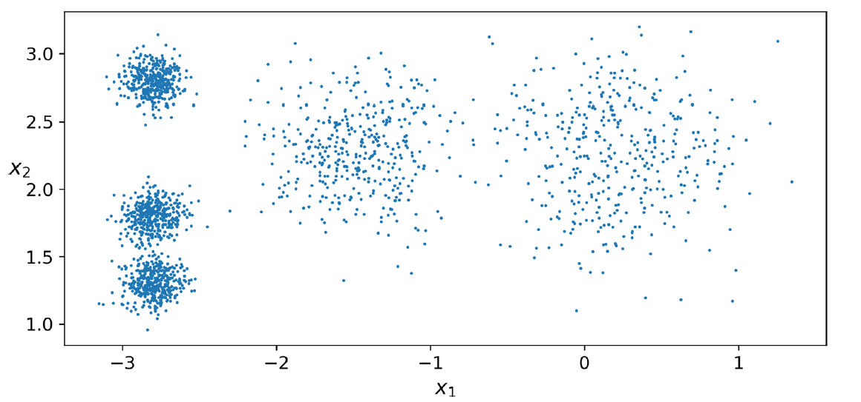
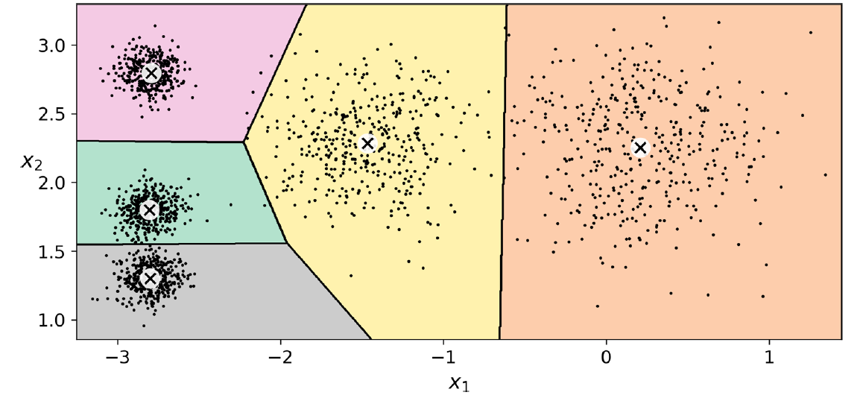
K-Means Clustering

Slide 7
K-means clustering
Instead of assigning each instance to a single cluster, which is called hard clustering, it can be useful to give each instance a score per cluster, which is called soft clustering.
The score can be the distance between the instance and the centroid; conversely, it can be a similarity score (or affinity), such as the Gaussian Radial Basis Function.
The computational complexity of the algorithm is generally linear with regard to the number of instances m, the number of clusters k, and the number of dimensions n. However, this is only true when the data has a clustering structure. If it does not, then in the worstcase scenario the complexity can increase exponentially with the number of instances. In practice, this rarely happens, and K-Means is generally one of the fastest clustering algorithms.

Slide 9
Steps in K-means clustering algorithm
Choose Number of Clusters (K)
Select the number of clusters K based on the problem requirement.
Methods like the Elbow Method can help in choosing optimal K.
Initializing Random Centroids
Randomly select K data points as the initial cluster centroids.
These centroids represent the center of each cluster.
Assign Data Points to Nearest Centroid
For each data point, compute the distance (usually Euclidean distance) from all centroids.
Assign each point to the cluster with the minimum distance.

Slide 10

Steps in K-means clustering algorithm
Update Centroids
Recalculate the centroid of each cluster by taking the mean of all points assigned to that cluster.
Check for Convergence
Compare old and new centroids.
If centroids do not change (or change is below a threshold), the algorithm stops.
Otherwise, repeat Steps 3 and 4.

Slide 11

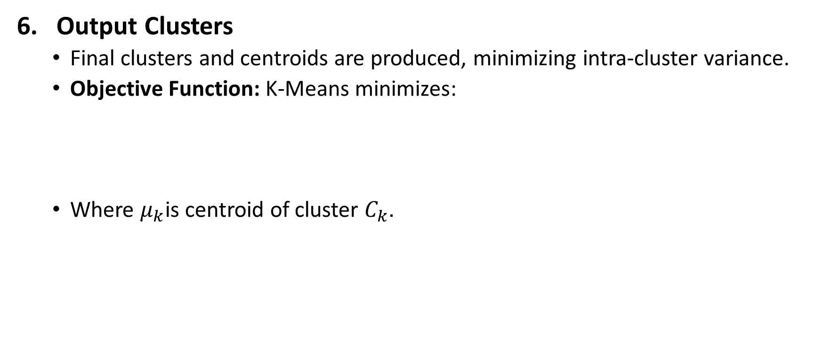
Steps in K-means clustering algorithm
Output Clusters
Final clusters and centroids are produced, minimizing intra-cluster variance.
Objective Function: K-Means minimizes:
Where $μ_{k}$is centroid of cluster $C_{k}$.

Slide 12
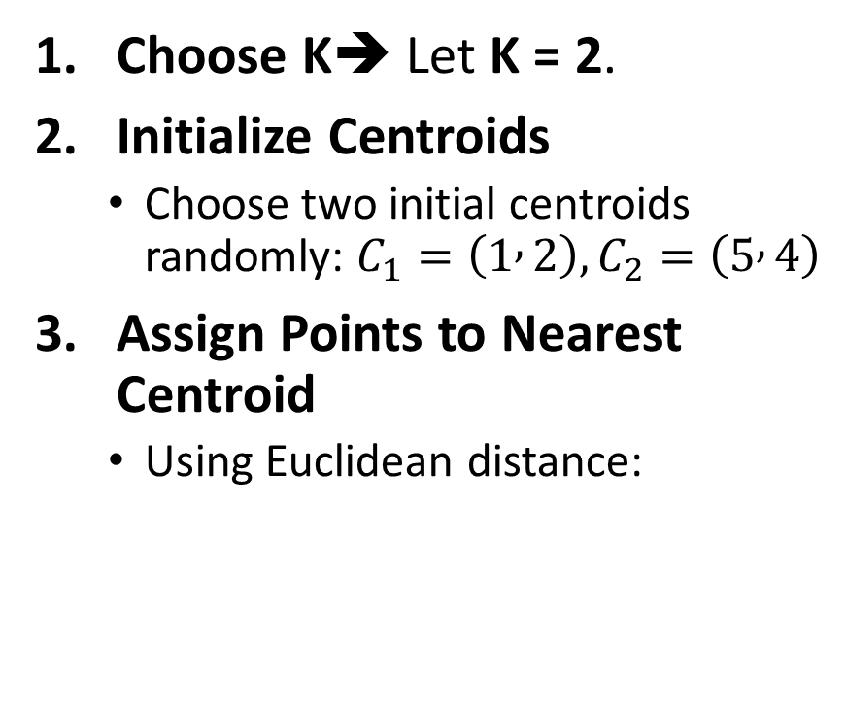
Simple Example of K-Means Clustering
Assume we have 6 data points representing students based on two features: Study Hours (X) and Marks (Y).
Choose K➔ Let K = 2.
Initialize Centroids
Choose two initial centroids randomly: $C_{1}=\left(1 , 2\right), C_{2}=\left(5 , 4\right)$
Assign Points to Nearest Centroid
Using Euclidean distance:
Student | X (Hours) | Y (Marks)
A | 1 | 2
B | 2 | 1
C | 4 | 5
D | 5 | 4
E | 6 | 5
F | 7 | 6

Slide 13
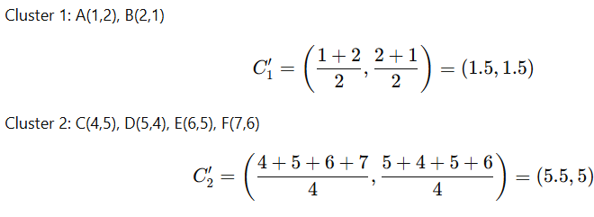


Simple Example of K-Means Clustering
Assign Points to Nearest Centroid
Using Euclidean distance:
Update Centroids
$$C_{1}=\left(1 , 2\right), C_{2}=\left(5 , 4\right)$$
Point | Dist to C₁ | Dist to C₂ | Cluster
A(1,2) | 0 | 4.47 | C₁
B(2,1) | 1.41 | 4.24 | C₁
C(4,5) | 4.24 | 1.41 | C₂
D(5,4) | 4.47 | 0 | C₂
E(6,5) | 5.66 | 1.41 | C₂
F(7,6) | 7.21 | 2.83 | C₂
Cluster 1 → A, B, Cluster 2 → C, D, E, F

Slide 14
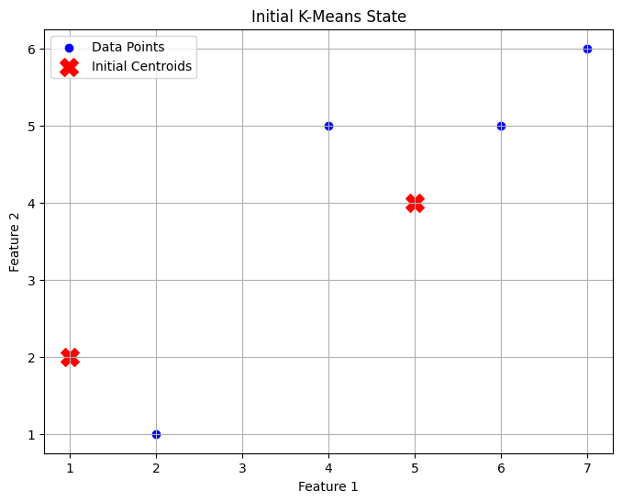
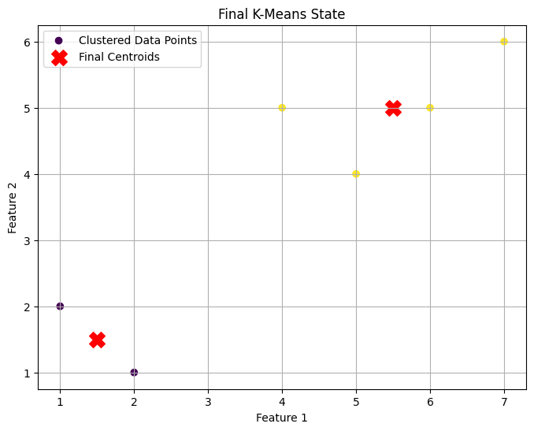
Simple Example of K-Means Clustering

Slide 15
Simple Example of K-Means Clustering
Repeat Step 3, 4
Assign Points to Nearest Centroid
Using Euclidean distance:
Update Centroids
$$C_{1}=\left(1.5 , 1.5\right), C_{2}=\left(5.5 , 5\right)$$
Point | d to C₁ | d to C₂ | Assigned Cluster
A | 0.71 | 5.41 | C₁
B | 0.71 | 5.32 | C₁
C | 4.30 | 1.50 | C₂
D | 4.30 | 1.12 | C₂
E | 5.70 | 0.50 | C₂
F | 7.11 | 1.80 | C₂
Cluster 1 → A, B, Cluster 2 → C, D, E, F

Slide 16
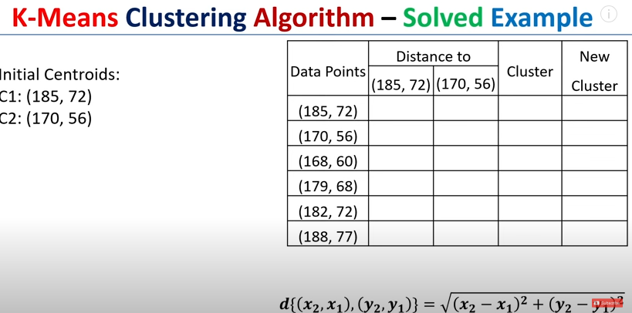

Slide 17
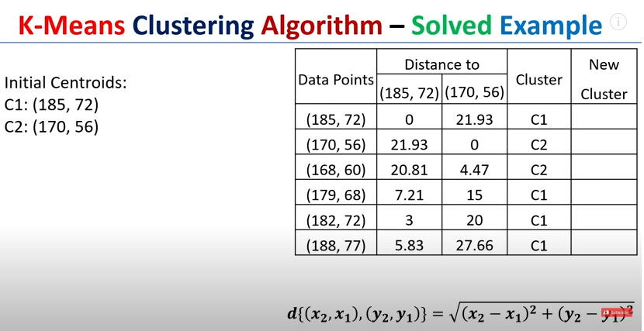

Slide 18
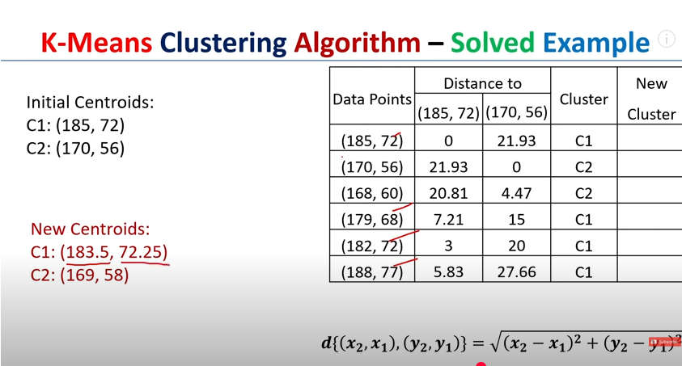

Slide 19
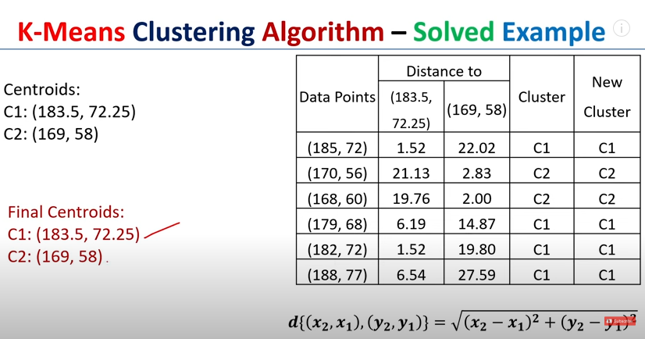

Slide 20
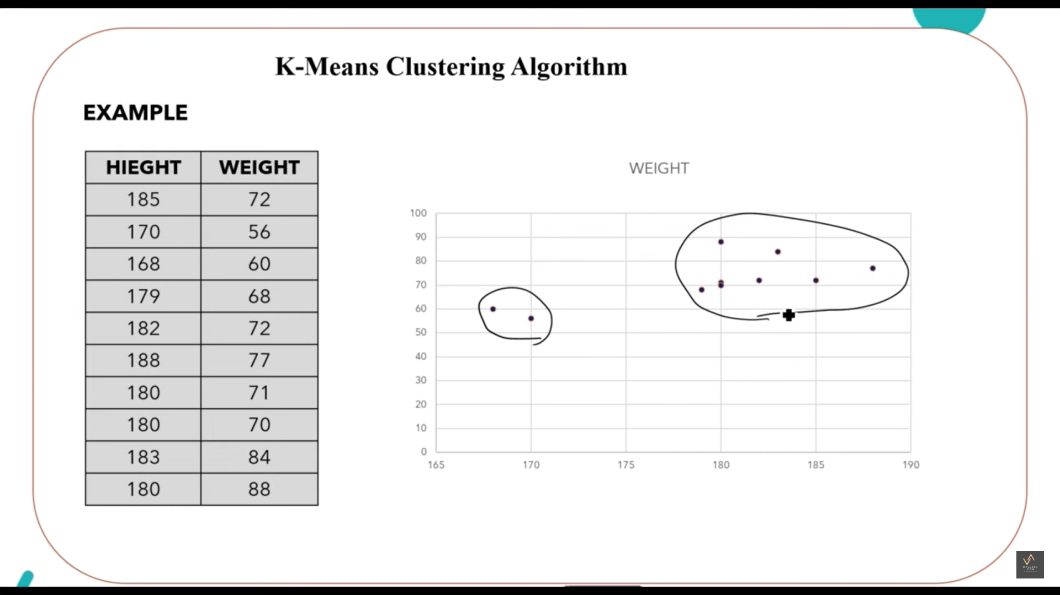

Slide 21
Limitations of k means clustering
K-means clustering needs the number of clusters to be specified.
K-means has problems when clusters are of differing sized, densities, and nonglobular shapes.
Presence of outlier can skew the results.

Slide 22
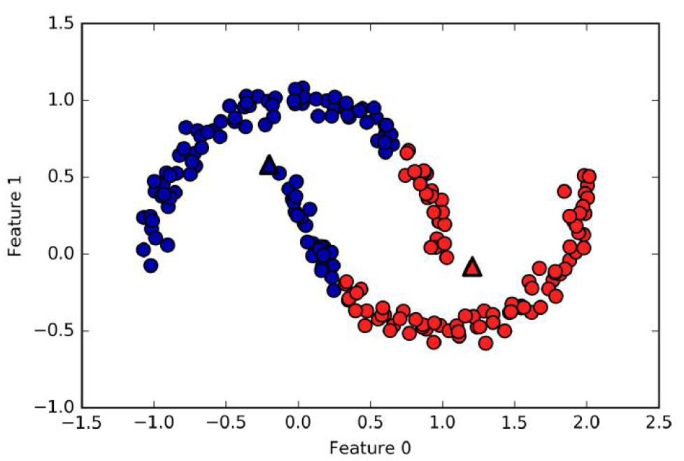
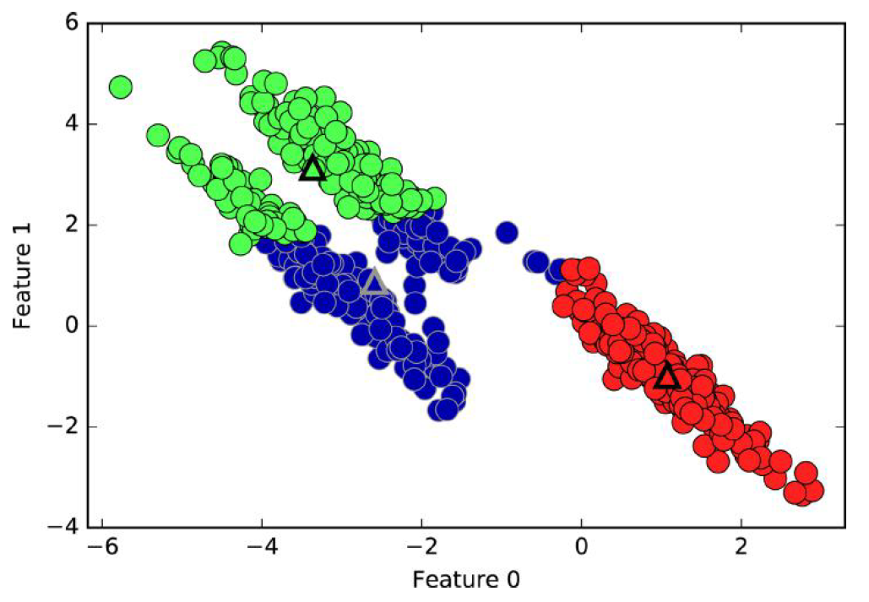
Failure cases of k-means
k-means fails to identify nonspherical clusters
k-means fails to identify clusters with complex shapes

Slide 23
Use cases
K-Means is widely used for many applications.
Image Segmentation
Clustering Gene Segmentation Data
News Article Clustering
Clustering Languages
Species Clustering
Anomaly Detection

Slide 24
K-Means++ Clustering
An important improvement to the K-Means algorithm, K-Means++, was proposed in a 2006 paper by David Arthur and Sergei Vassilvitskii.
They introduced a smarter initialization step that tends to select centroids that are distant from one another, and this improvement makes the K-Means algorithm much less likely to converge to a suboptimal solution.
They showed that the additional computation required for the smarter initialization step is well worth it because it makes it possible to drastically reduce the number of times the algorithm needs to be run to find the optimal solution.

Slide 25
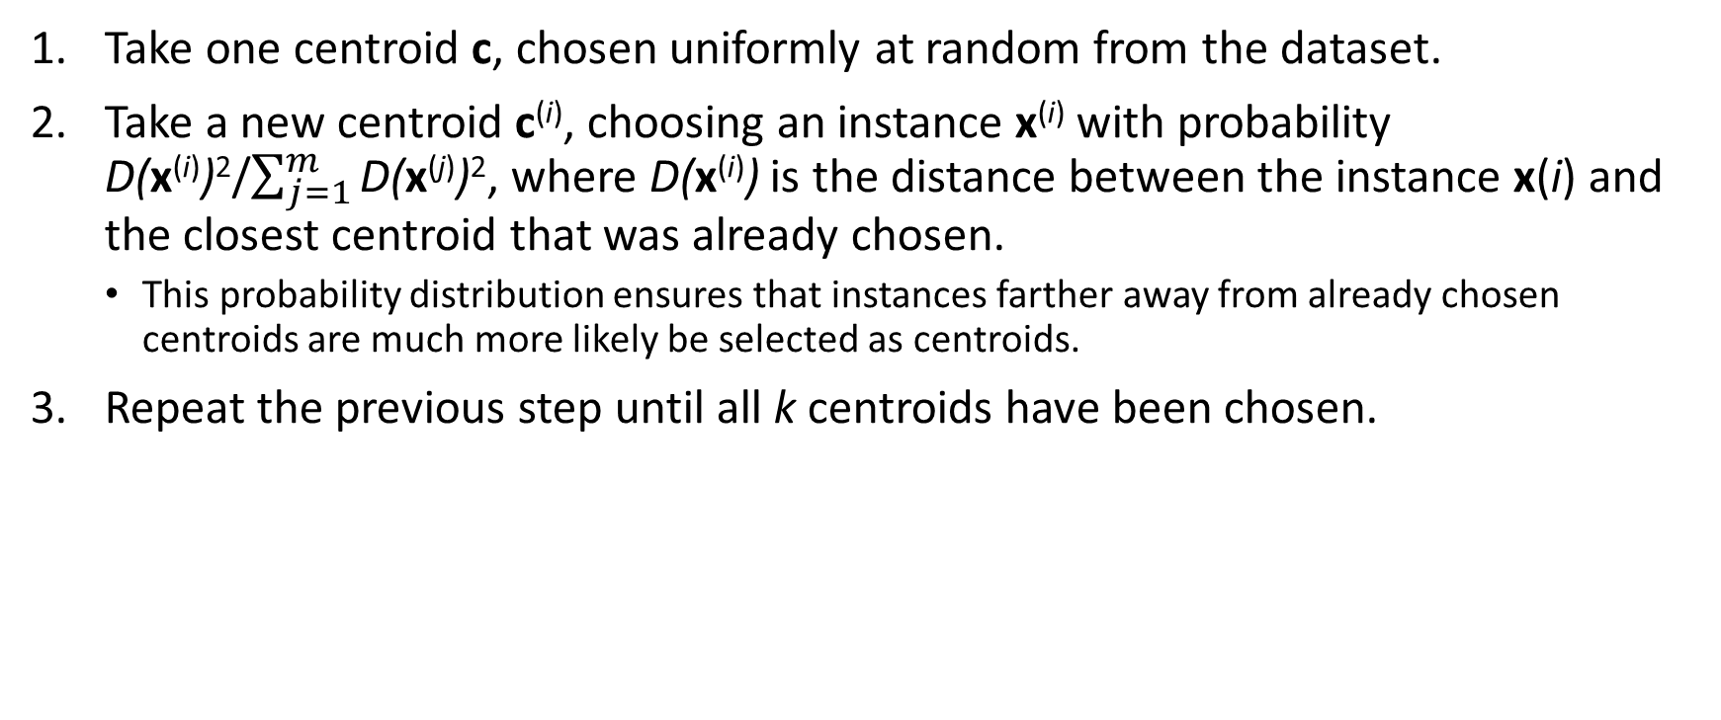
K-Means++ initialization algorithm:
Take one centroid c, chosen uniformly at random from the dataset.
Take a new centroid c^{(i)}, choosing an instance x^{(i)} with probability D(x^{(i)})²/$\sum_{j=1}^{m}{\text{D}\text{(}\text{x}\text{(}\text{j}\text{)}\text{)}\text{2}}$, where D(x^{(i)}) is the distance between the instance x(i) and the closest centroid that was already chosen.
This probability distribution ensures that instances farther away from already chosen centroids are much more likely be selected as centroids.
Repeat the previous step until all k centroids have been chosen.

Slide 26

Simple Example of K-Means++ Clustering
Assume we have 6 data points representing students based on two features: Study Hours (X) and Marks (Y).
Choose K➔ Let K = 2.
Choose First Centroid Randomly: $C_{1}=\left(1 , 2\right)$
Compute Distance² from $C_{1}$
Point | Distance from (1,2) | Distance²
A(1,2) | 0 | 0
B(2,1) | √2 ≈ 1.41 | 2
C(4,5) | √18 ≈ 4.24 | 18
D(5,4) | √20 ≈ 4.47 | 20
E(6,5) | √34 ≈ 5.83 | 34
F(7,6) | √52 ≈ 7.21 | 52
Student | X (Hours) | Y (Marks)
A | 1 | 2
B | 2 | 1
C | 4 | 5
D | 5 | 4
E | 6 | 5
F | 7 | 6
The largest value is for F(7,6). So choose: $C_{2}=\left(7 , 6\right)$

Slide 27
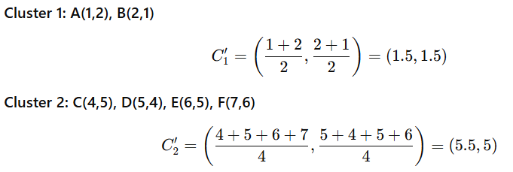

Simple Example of K-Means++ Clustering
Assign Points to Nearest Centroid
Compute distance to $C_{1}\left(1 , 2\right)$and $C_{2}\left(7 , 6\right)$
Update Centroids
Point | d to C₁ | d to C₂ | Cluster
A(1,2) | 0 | 7.21 | C₁
B(2,1) | 1.41 | 7.07 | C₁
C(4,5) | 4.24 | 3.61 | C₂
D(5,4) | 4.47 | 2.83 | C₂
E(6,5) | 5.83 | 1.41 | C₂
F(7,6) | 7.21 | 0 | C₂
So:
Cluster 1: A, B
Cluster 2: C, D, E, F

Slide 28
Simple Example of K-Means++ Clustering- Repeat step 3,4
Assign Points to Nearest Centroid
Compute distance to $C_{1}\left(1 , 2\right)$and $C_{2}\left(7 , 6\right)$
Update Centroids
Point | d to C₁ | d to C₂ | Cluster
A(1,2) | 0.71 | 5.41 | C₁
B(2,1) | 0.71 | 5.32 | C₁
C(4,5) | 4.3 | 1.5 | C₂
D(5,4) | 4.3 | 1.12 | C₂
E(6,5) | 5.7 | 0.5 | C₂
F(7,6) | 7.11 | 1.8 | C₂
So no change in the cluster points and its centroids
Cluster 1: A, B
Cluster 2: C, D, E, F

Slide 29
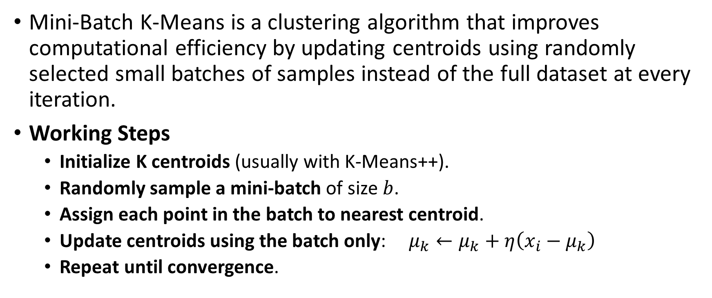
Mini-Batch K-Means
Mini-Batch K-Means is a clustering algorithm that improves computational efficiency by updating centroids using randomly selected small batches of samples instead of the full dataset at every iteration.
Working Steps
Initialize K centroids (usually with K-Means++).
Randomly sample a mini-batch of size $b$.
Assign each point in the batch to nearest centroid.
Update centroids using the batch only: $μ_{k}←μ_{k}+η\left(x_{i}−μ_{k}\right)$
Repeat until convergence.

Slide 30
Feature | K-Means | K-Means++ | Mini-Batch K-Means
Initialization | Random centroids | Smart (distance-based) initialization | Uses K-Means++ usually
Dataset size | Small–medium | Medium–large | Very large datasets
Speed | Moderate | Faster than K-Means | Very fast
Memory use | Higher | Same as K-Means | Low
Convergence | Slower, unstable | Faster, stable | Fast, approximate
Cluster quality | Can be poor due to random start | Better, more consistent | Slightly less accurate
Iterations | More | Fewer | Very few
Sensitivity | Sensitive to initialization | Less sensitive | Less sensitive
Scalability | Limited | Better | Highly scalable
Use case | Simple problems | Production clustering | Big data / streaming data

Slide 31
Finding the optimal number of clusters
There are two commonly used methods to determine the ideal number of clusters possible in K-means
Elbow Method
Silhouette Method

Slide 32

Elbow Method
First of all, compute the sum of squared error (SSE) for some values of k. The SSE is defined as the sum of the squared distance between each member of the cluster and its centroid. Mathematically:
If you plot k against the SSE, you will see that the error decreases as k gets larger; this is because when the number of clusters increases, they should be smaller, so distortion is also smaller. The idea of the elbow method is to choose the k at which the SSE decreases abruptly. This produces an "elbow effect" in the graph

Slide 33
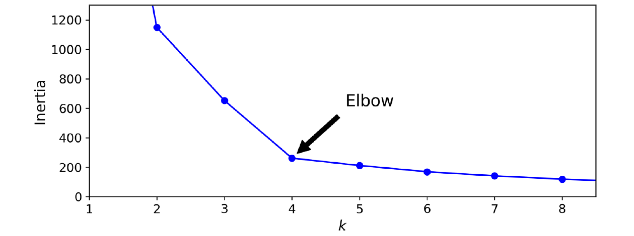
Elbow Method

Slide 34
Silhouette Method
Silhouette analysis is a way to measure how close each point in a cluster is to the points in its neighboring clusters.
Its a way to find out the optimum value for k during k-means clustering.
Silhouette values lies in the range of [-1, 1].
A value of +1 indicates that the sample is far away from its neighboring cluster and very close to the cluster its assigned.
Similarly, value of -1 indicates that the point is close to its neighboring cluster than to the cluster its assigned.
A value of 0 means its at the boundary of the distance between the two cluster. Value of +1 is idea and -1 is least preferred. Hence, higher the value better is the cluster configuration.

Slide 35

Silhouette Method
In the data, lets define a(i) to be the mean distance of point (i) w.r.t to all the other points in the cluster its assigned (A).
We can interpret a(i) as how well the point is assigned to the cluster. Smaller the value better the assignment.
Similarly, lets define b(i) to be the mean distance of point(i) w.r.t. to other points to its closet neighboring cluster (B). The cluster (B) is the cluster to which point (i) is not assigned to but its distance is closest amongst all other cluster.
Thus, the silhouette s(i) can be calculated as:

Slide 36
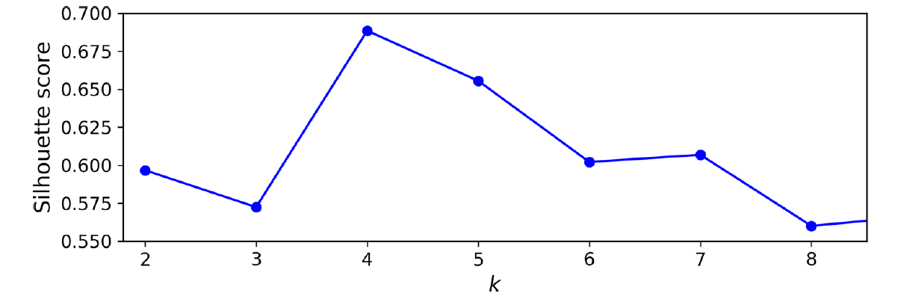
Silhouette Method

